Slide 1
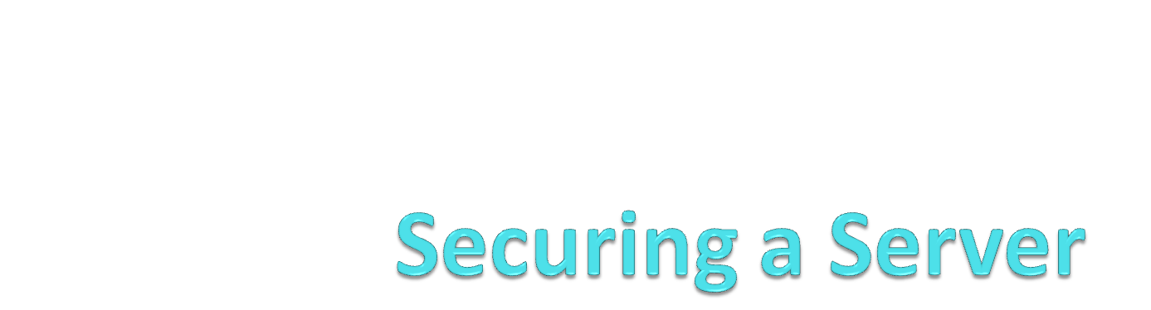
OPS110

Slide 2
Objectives
Describe methods to ensure your server is secure, or “harden” your server
Describe Disk Quotas
Use the Security Configuration Wizard
Use Group Policy Objects to secure your server
Secure your network using Firewalls
Describe Windows Update
Describe Microsoft Baseline Security Analyzer

Slide 3
Steps to “Harden” Your Server
Secure the server with good physical security
Create a Decoy administrative account and rename the true Administrator account
Disable unnecessary applications and services
Limit remote administration to specific users
Set Disk Quotas and Create Large File on AD volume
Create a security baseline using Security Configuration Wizard (SCW)
Create a Group Policy Object for the Domain
Configure the Windows Firewall
Download the latest patches for OS and applications
Test the system using Microsoft Baseline Security Analyzer (M BSA)

Slide 4
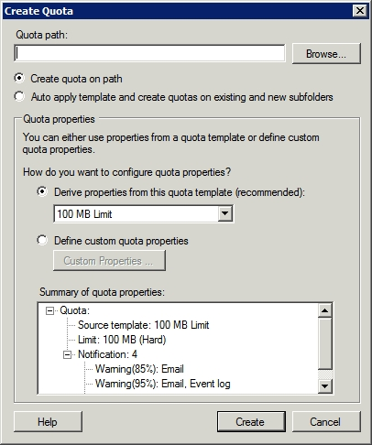
Disk Quotas
One of the commonly attacked system resources is available disk space.
Set disk quotas to restrict the amount of space that is available to each user.
Notes:
As you can see in the figure, the first thing that you have to provide is the file system path that you want to apply the quota to. After you specify a path, you need to tell Windows whether you want to simply apply the quota to the path, or if you are planning on basing the quota template, and want to apply the template in a way that allows the quota to extend to both new and to existing subfolders.
The next section on the Create Quota dialog box allows you to choose whether you want to use an existing quota template, or whether you want to define a custom set of properties for the disk quota. Microsoft recommends that you use a quota template. If you want to use a quota template, then simply select the template that you want to use from the drop-down list. The bottom section of the dialog box provides a summary of the settings within the selected template.
Of course creating a custom quota is also an option. To do so, just click the Define Custom Quota Properties button, and then click the Custom Properties button. This will provide you with an opportunity to enter the same types of information that you would normally provide when you are manually creating a quota template.
define the space limit that is associated with the quota. When you define the space limit, you must also tell Windows whether the template will define a hard quota or a soft quota. A hard quota is a quota that users are not allowed to exceed. A soft quota is generally used for monitoring purposes and is not actually enforced.
If you were thinking about implementing quotas in your organization, then I would recommend starting out with soft quotas. This gives you a chance to test all of your quotas without actually impacting the end users. Once you are confident that the quotas work the way that you think they should, you can make the switch to hard quotas.
The last section in this dialog box allows you to control what happens at various threshold levels. In this particular case, an e-mail warning is generated when a user has used 80% of their allotted disk space. When the closure eventually met, an e-mail message is sent to the user, and an event log entry is also generated. Since the dialog box shown in Figure A applies to a soft quotas, we also have a warning that is generated when a user exceeds 120% of their allotted disk space. Once again, Windows sends an e-mail message and generates an event log entry. If you look closely at the dialog box though, you will notice that we also have the option of executing a command or of generating a report.

Slide 5
Security Configuration Wizard (SCW)
guides you through the process of creating, editing, applying, or rolling back a security policy
an easy way to create or modify a security policy for your server based on its role
compare a server's security settings with a desired security policy to check for vulnerable configurations in the system

Slide 6
What SCW Does for Us….
SCW determines the minimum functionality required for a server's role or roles, and disables functionality that is not required.
  Disables unneeded services.
  Blocks unused ports.
  Allows further address or security restrictions for ports that are left open.
  Prohibits unnecessary Internet Information Services (IIS) Web extensions, if applicable.

Slide 7
Introducing Group Policy
Group Policy is a mechanism for controlling and deploying operating system settings to computers all over your network
Consists of user and computer settings for the various Microsoft Windows operating systems,
Implemented during computer startup and shutdown and user logon and logoff
Configure one or more Group Policy objects (GPOs) and then use a process called linking to associate them with specific Active Directory Domain System (AD DS) objects
When you link a GPO to a container object, all of the objects in that container receive the settings you configured in the GPO
Notes:
Review the list of settings that Group Policy can be used to manage in the textbook.

Slide 8
Group Policy: User Benefits
Users can access their files, even when network connectivity is intermittent. This is accomplished by using folder redirection and offline files.
Users can work with a consistent computing environment, regardless of which workstation or location they use to log on.
User files redirected to a server location can be backed up regularly, saving users from data loss due to workstation failure .
Applications that become damaged or need to be updated can be reinstalled or maintained automatically.

Slide 9
Group Policy: Administrative Benefits
Administrators have control over centralized configuration of user settings, application installation, and desktop configuration.
Problems due to missing application files and other minor application errors often can be alleviated by the automation of application repairs.
Centralized administration of user files eliminates the need and cost of trying to recover files from a damaged drive.
The need to manually make security changes is reduced by the rapid deployment of new settings through Group Policy.

Slide 10
Group Policy Objects (GPOs)
Group Policy objects (GPOs) contain all of the Group Policy settings that administrators can deploy to user and computer objects within a site, domain, or organizational unit.
To deploy a GPO, an administrator must associate it with the container to which it is deployed (Linking)
Administrative tasks for Group Policy include:
  creating GPOs
  specifying where GPOs are stored
  managing the AD DS links
© 2013 John Wiley & Sons, Inc.

Slide 11
Types of GPOs
There are three types of GPOs:
Local GPOs – on the local computer only
Domain GPOs – created in Active Directory
  Linked to sites, domains or OUs
Starter GPOs – template GPO based on a standard collection of settings
Notes:
Describe the 3 different types of GPOs

Slide 12
Password Policies
Use the Local Security Policy, or Group Policy on a Domain to configure Password Policies to ensure users use Strong Passwords
  Password length (the most secure are 7 or 14 characters)
  Complexity (require a combination of character types)
  Have passwords expire (require users to change passwords)
  Save a password history (New passwords must be different from prior passwords)
Notes:
Passwords are the simplest security measures to implement and the weakest link in a computer security. CERT states that 80% of computer break ins are result of weak password. Strong passwords are important because password cracking tools can crack any word that is in the English dictionary in under a second. Thus a good password is actually an collection of letters based on a “ a pass phrase” A strong password is at least 6 to 14 characters in length and is made up of the following:
Use at least one symbol character
Use at least one number
Use upper and lower case
• Is a word not in the dictionary
Is significantly different from prior passwords.
A good password also does contain contain your name or user name.
Windows XP passwords can be up to 127 characters long, if you need to communicate with Win9x or NT then the maximum length is 14 characters. XP will also prevent an account with a black passordrd from

Slide 13
Building a Firewall
A firewall is a software program that protects a computer or a network by allowing certain types of network traffic in and out of the system while blocking others.
A firewall is essentially a series of filters that examine the contents of packets and the traffic patterns to and from the network to determine which packets they should allow to pass through the filter.

Slide 14
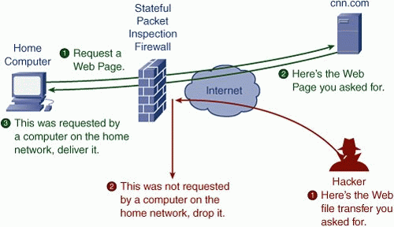
Firewalls

Slide 15
Firewalls Protect Against:
Network scanner applications that probe systems for unguarded ports, which are essentially unlocked doors that attackers can use to gain access to the system.
Trojan horse applications that open a connection to a computer on the Internet, enabling an attacker on the outside to run programs or store data on the system.
Attackers that obtain passwords by illicit means, such as social engineering, and then use remote access technologies to log on to a computer from another location and compromise its data and programming.
Denial of service attacks that use authorized access points to bombard a system with traffic, preventing legitimate traffic from reaching the computer.

Slide 16
Firewall Settings
The three most important criteria that firewalls can use in their rules are as follows:
IP addresses identify specific hosts on the network. You can use IP addresses to configure a firewall to allow only traffic from specific computers or networks in and out.
Protocol numbers specify whether the packet contains TCP or UDP (User Datagram Protocol) traffic. You can filter protocol numbers to block packets containing certain types of traffic.
Port numbers identify specific applications running on the computer. The most common firewall rules use port numbers to specify the types of application traffic the computer is allowed to send and receive.

Slide 17
Firewall Settings
Firewall rules can function in two ways:
Admit all traffic, except that which conforms to the applied rules
Block all traffic, except that which conforms to the applied rules
© 2013 John Wiley & Sons, Inc.

Slide 18
Working with Windows Firewall
The Windows Firewall control panel provides a simplified interface that enables you to avoid the details of rules and port numbers.
For full access to firewall rules and more sophisticated functions, you must use the Windows Firewall with Advanced Security console
Many of the roles and features included in Windows Server automatically open the appropriate firewall ports when you install them.
The system warns you of firewall issues.

Slide 19
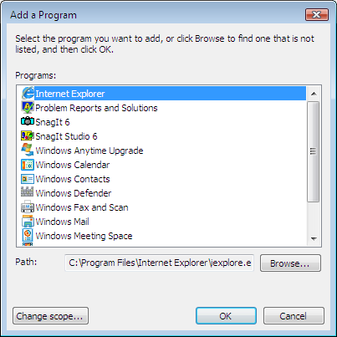
Creating a Firewall Exception
Click Start, and then click Control Panel.
Click Allow A Program Through Windows Firewall.
Click Add Program.

Slide 20
Creating a Windows Firewall with Advanced Security Console
Click Start, type mmc in the Start Search box, and press Enter.
Click File > Add/Remove Snap-In.
Scroll down in the Available Snap-ins list, select Windows Firewall With Advanced Security, and click Add.
Click Finish to accept the default Local Computer option.
Click OK.

Slide 21
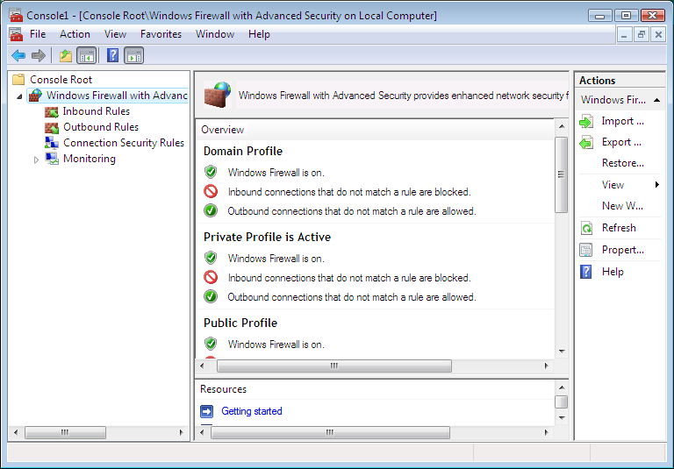
Windows Firewall with Advanced Security
Gives full access to Windows Firewall configuration settings.

Slide 22
Windows Update
Provides updates for the Microsoft Windows operating system and its installed components
  Security updates or critical updates protect against vulnerabilities to malware and security exploits
  Other updates correct errors that aren't related to security, or enhance functionality
Security updates are routinely provided on the second Tuesday of each month, Patch Tuesday, but can be provided whenever a new update is urgently required to prevent a newly discovered or prevalent exploit targeting Windows users

Slide 23
Microsoft Baseline Security Analyzer (MBSA)
Used to determine security state by assessing missing security updates and less-secure security settings within Microsoft Windows, Windows components and products, Microsoft SQL Server, and Microsoft Office macro settings
Security updates are determined by the current version of MBSA using the Windows Update Agent
The less-secure settings, often called Vulnerability Assessment (VA) checks, are assessed based on a hard-coded set of registry and file checks.

Slide 24
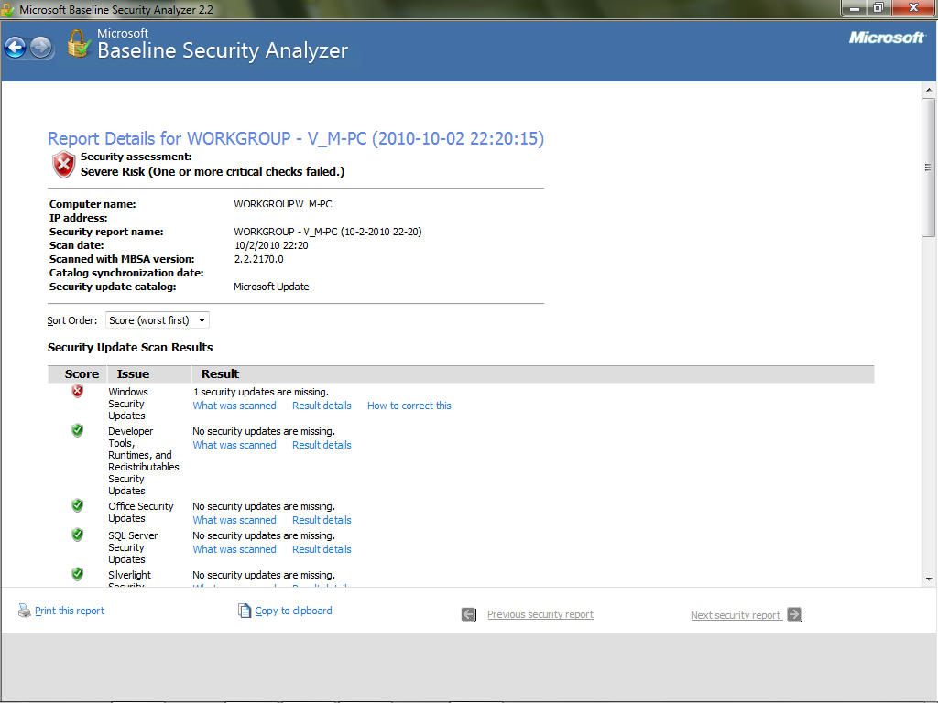
MBSA

